Slide 1
OpenFIDO
Data Exchange Implementation and Validation Plan
SLAC National Accelerator Laboratory
Last update: February 2019

Slide 2
OpenFIDO Workflow
Data
OpenFIDO Desktop
Ingest
Curate
Analyse
Models
Export
OpenFIDO App store
GridLAB-D
Other tools
shaper
player
schedule
object
CIM
PNG

Slide 3
Ingest
Data/model sources: local machine, local server, cloud servers (e.g., AWS)
Data types: CSV, MySQL, Postgres, JSON, XML, XLS, etc.
Model types: CIM, GLM, Cyme, and Synergi (others?)
Access control: policies set during import, limited by user privileges

Slide 4
Curate
Provides API to manage data access, quality, and provenance tracking

Slide 5
Analyse
Provide API to process data

Slide 6
Export - GridLAB-D data source
Generates data source definitions
Players and shaper objects:
Player settings (filename, interval, loops, etc)
Player on_init event handler to download original data to local cache
Shapers include statistical properties
Schedule definitions from data
User controls schedule structure (blocks, normalization, boolean, etc.)
Calculates schedule values based on schedule structure (mean, mode, median, min, max, stdev, etc).

Slide 7
Export - GridLAB-D models
Object properties (e.g., temperature sensitivity)
Individual objects (e.g., single calibrated house model)
Stochastic objects (e.g., calibrated house model using distributions)
Object lists (e.g., collections of meters)
Object networks (e.g., a distribution system model)

Slide 8
Export - Other tools
CIM model export
Plotting output support (e.g., PNG, PDF)

Slide 9
Desktop
Collection of Python tk interface components
“App store” model based on github repo contents
Consolidated UI for direct use + UI components for GLOW

Slide 10
OpenFIDO Wireframe 1
Data
CSV
MySQL
Model
GridLAB-D
Player
Shaper
Schedule
Cyme
Sinergi
CIM
Process
Data to GLM
My_AMI
AMI to GLM
my_data

Slide 11
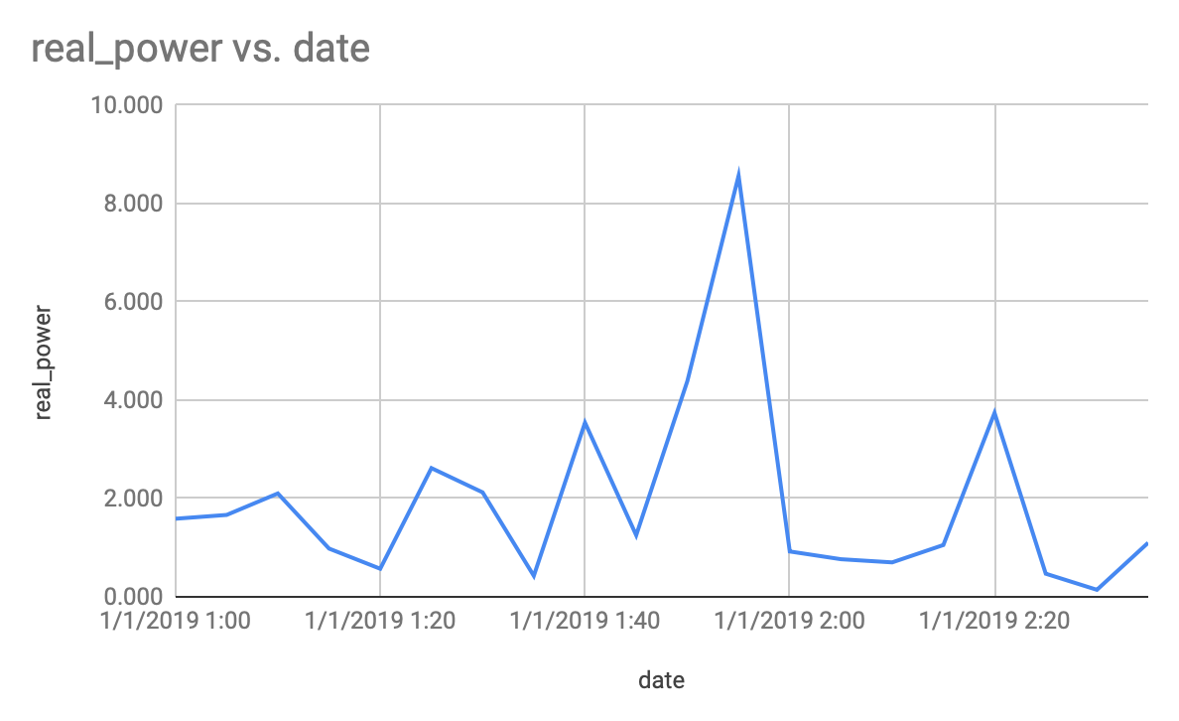
OpenFIDO Wireframe 1
Data
CSV
MySQL
Model
GridLAB-D
Player
Shaper
Schedule
Cyme
Sinergi
CIM
Process
Data to GLM
File: ami_data.csv
date | real_power | reactive_power
1/1/2019 1:00 | 1.587 | 0.175
1/1/2019 1:05 | 1.664 | 0.182
1/1/2019 1:10 | 2.101 | 0.241
1/1/2019 1:15 | 0.980 | 0.108
1/1/2019 1:20 | 0.570 | 0.066
1/1/2019 1:25 | 2.617 | 0.284
1/1/2019 1:30 | 2.123 | 0.247
1/1/2019 1:35 | 0.426 | 0.044
1/1/2019 1:40 | 3.541 | 0.378
1/1/2019 1:45 | 1.252 | 0.143
1/1/2019 1:50 | 4.389 | 0.524
1/1/2019 1:55 | 8.563 | 0.911
1/1/2019 2:00 | 0.921 | 0.105
1/1/2019 2:05 | 0.764 | 0.085
1/1/2019 2:10 | 0.699 | 0.075
1/1/2019 2:15 | 1.052 | 0.122
1/1/2019 2:20 | 3.739 | 0.403
1/1/2019 2:25 | 0.469 | 0.056
1/1/2019 2:30 | 0.141 | 0.016
1/1/2019 2:35 | 1.098 | 0.114
Time series
Scatter
Histogram
date
real_power
reactive_power

Slide 12
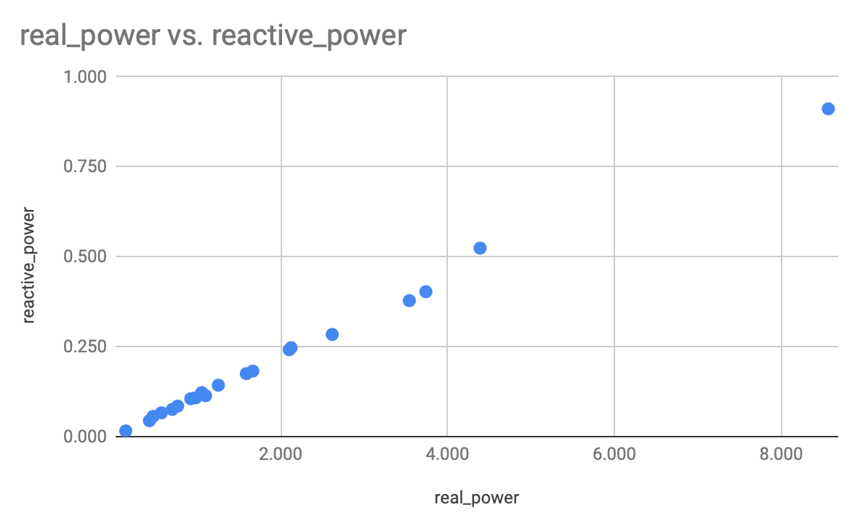
OpenFIDO Wireframe 1
Data
CSV
MySQL
Model
GridLAB-D
Player
Shaper
Schedule
Cyme
Sinergi
CIM
Process
Data to GLM
File: ami_data.csv
date | real_power | reactive_power
1/1/2019 1:00 | 1.587 | 0.175
1/1/2019 1:05 | 1.664 | 0.182
1/1/2019 1:10 | 2.101 | 0.241
1/1/2019 1:15 | 0.980 | 0.108
1/1/2019 1:20 | 0.570 | 0.066
1/1/2019 1:25 | 2.617 | 0.284
1/1/2019 1:30 | 2.123 | 0.247
1/1/2019 1:35 | 0.426 | 0.044
1/1/2019 1:40 | 3.541 | 0.378
1/1/2019 1:45 | 1.252 | 0.143
1/1/2019 1:50 | 4.389 | 0.524
1/1/2019 1:55 | 8.563 | 0.911
1/1/2019 2:00 | 0.921 | 0.105
1/1/2019 2:05 | 0.764 | 0.085
1/1/2019 2:10 | 0.699 | 0.075
1/1/2019 2:15 | 1.052 | 0.122
1/1/2019 2:20 | 3.739 | 0.403
1/1/2019 2:25 | 0.469 | 0.056
1/1/2019 2:30 | 0.141 | 0.016
1/1/2019 2:35 | 1.098 | 0.114
Time series
Scatter
Histogram
date
real_power
reactive_power

Slide 13
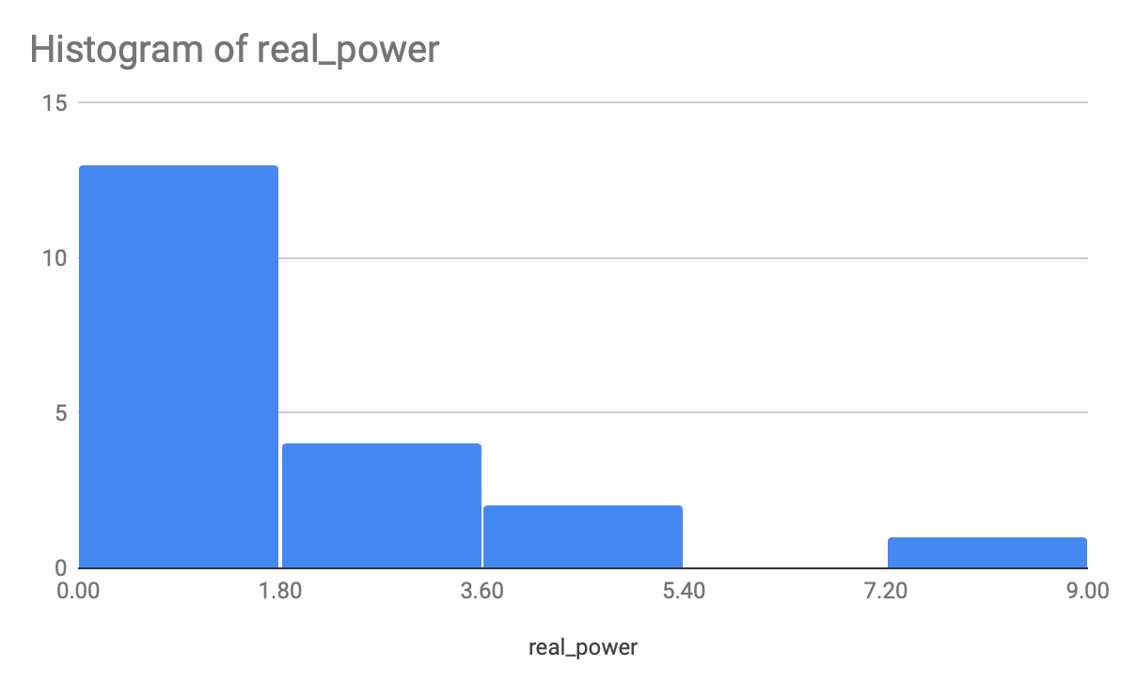
OpenFIDO Wireframe 1
Data
CSV
MySQL
Model
GridLAB-D
Player
Shaper
Schedule
Cyme
Sinergi
CIM
Process
Data to GLM
File: ami_data.csv
date | real_power | reactive_power
1/1/2019 1:00 | 1.587 | 0.175
1/1/2019 1:05 | 1.664 | 0.182
1/1/2019 1:10 | 2.101 | 0.241
1/1/2019 1:15 | 0.980 | 0.108
1/1/2019 1:20 | 0.570 | 0.066
1/1/2019 1:25 | 2.617 | 0.284
1/1/2019 1:30 | 2.123 | 0.247
1/1/2019 1:35 | 0.426 | 0.044
1/1/2019 1:40 | 3.541 | 0.378
1/1/2019 1:45 | 1.252 | 0.143
1/1/2019 1:50 | 4.389 | 0.524
1/1/2019 1:55 | 8.563 | 0.911
1/1/2019 2:00 | 0.921 | 0.105
1/1/2019 2:05 | 0.764 | 0.085
1/1/2019 2:10 | 0.699 | 0.075
1/1/2019 2:15 | 1.052 | 0.122
1/1/2019 2:20 | 3.739 | 0.403
1/1/2019 2:25 | 0.469 | 0.056
1/1/2019 2:30 | 0.141 | 0.016
1/1/2019 2:35 | 1.098 | 0.114
Time series
Scatter
Histogram
date
real_power
reactive_power

Slide 14
OpenFIDO Wireframe 1
Data
CSV
MySQL
Model
GridLAB-D
Player
Shaper
Schedule
Cyme
Sinergi
CIM
Process
Data to GLM
Player: my_data
File name | my_data.csv
Parent type | powerflow:load
Target property | constant_power_A

Slide 15
OpenFIDO Wireframe 1
Data
CSV
MySQL
Model
GridLAB-D
Player
Shaper
Schedule
Cyme
Sinergi
CIM
Process
Data to GLM
Process: AMI to GLM
 | Input | Output
Class | Data | GLM
Type | CSV | player
Name | MY_AMI | my_data
Time | date | (auto)
Channel 1 | real_power | constant_power_A
Channel 2 | reactive_power | (none)

Slide 16
Workflow 1 pipeline instance
Note:
Parallelism is evident in instance structure
User does not need to know how the instance functions
ami.read("ami_data.csv")
player = ami.to_player([2])
player.write("my_ami.glm")
csv = ami.to_csv([1,2])
csv.write("my_ami.csv")

Slide 17
OpenFIDO Wireframe 2
Data
CSV
MySQL
Model
GridLAB-D
Player
Shaper
Schedule
Cyme
Sinergi
CIM
Process
Data to GLM
Filter
Resample
Decimate
Difference
Integrate
My_AMI
AMI to GLM
my_data
Resample
new_data

Slide 18
OpenFIDO Wireframe 2
Data
CSV
MySQL
Model
GridLAB-D
Player
Shaper
Schedule
Cyme
Sinergi
CIM
Process
Data to GLM
Filter
Resample
Decimate
Difference
Integrate
Filter: Resample
Input | Interval meter
Output | Schedule
Timestep | 1 hour
Method | Mean Summer Weekday

Slide 19
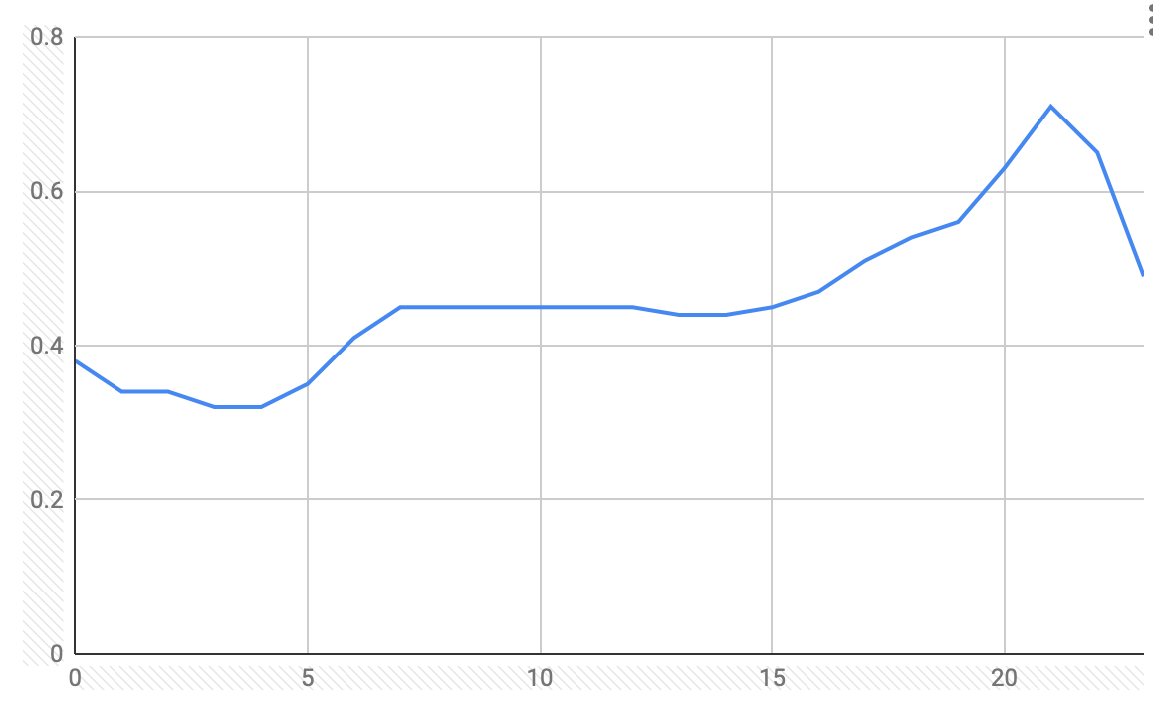
OpenFIDO Wireframe 2
Data
CSV
MySQL
Model
GridLAB-D
Player
Shaper
Schedule
Cyme
Sinergi
CIM
Process
Data to GLM
Filter
Resample
Decimate
Difference
Integrate
Schedule: Summer weekday average
 | Minutes | Hours | Days | Months | Weekdays | Value
Interval 1 | * | 0 | * | 4-9 | 1-5 | 0.38
Interval 2 | * | 1 | * | 4-9 | 1-5 | 0.34
Interval 3 | * | 2 | * | 4-9 | 1-5 | 0.34
Interval 4 | * | 3 | * | 4-9 | 1-5 | 0.32
Interval 5 | * | 4 | * | 4-9 | 1-5 | 0.32
Interval 6 | * | 5 | * | 4-9 | 1-5 | 0.35
Interval 7 | * | 6 | * | 4-9 | 1-5 | 0.41
Interval 8 | * | 7 | * | 4-9 | 1-5 | 0.45
Interval 9 | * | 8 | * | 4-9 | 1-5 | 0.45
Interval 10 | * | 9 | * | 4-9 | 1-5 | 0.45
Interval 11 | * | 10 | * | 4-9 | 1-5 | 0.45
Interval 12 | * | 11 | * | 4-9 | 1-5 | 0.45
Interval 13 | * | 12 | * | 4-9 | 1-5 | 0.45
Interval 14 | * | 13 | * | 4-9 | 1-5 | 0.44
Interval 15 | * | 14 | * | 4-9 | 1-5 | 0.44
Interval 16 | * | 15 | * | 4-9 | 1-5 | 0.45
Interval 17 | * | 16 | * | 4-9 | 1-5 | 0.47
Interval 18 | * | 17 | * | 4-9 | 1-5 | 0.51
Interval 19 | * | 18 | * | 4-9 | 1-5 | 0.54
Interval 20 | * | 19 | * | 4-9 | 1-5 | 0.56

